Slide 1

ADVANCE QUEENSLAND FUNDING PROGRAM
Python( Pandas, Numpy, Matplotlib, Seaborn, Plotly.express) and Power BI

Slide 2
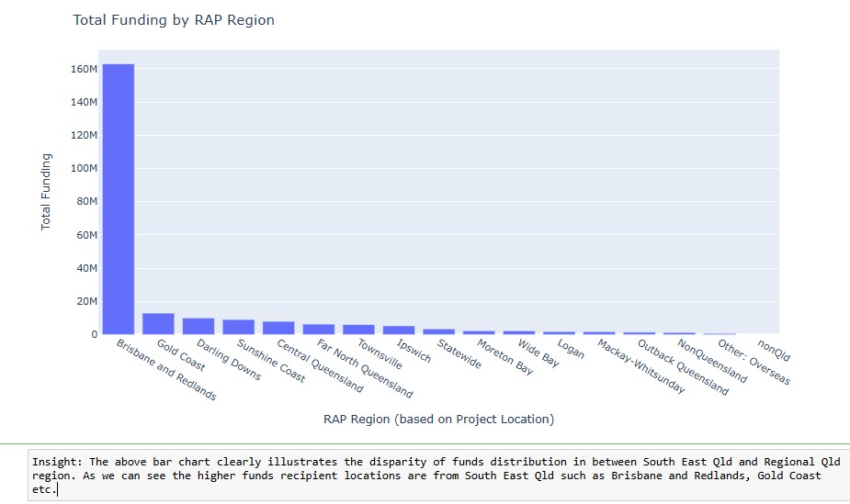
Disparity In the distribution of funds by RAP Region

Slide 3
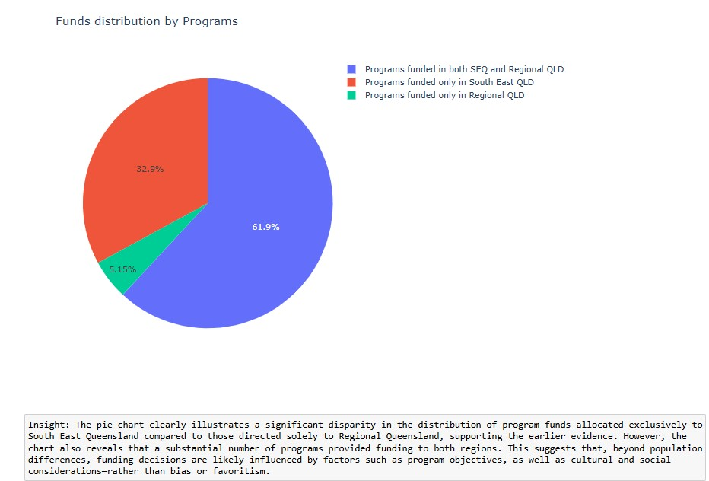
Disparity In the distribution of funds by programs

Slide 4
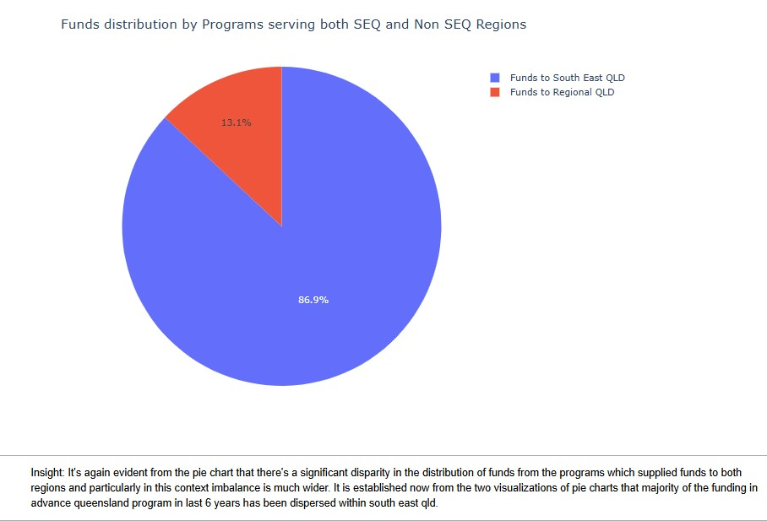
Disparity In the distribution of funds by programs which supplied funds to both regions

Slide 5
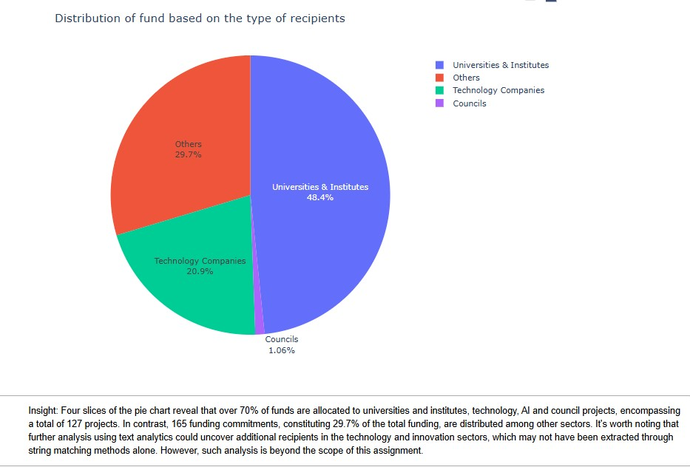
Disparity in the distribution of funds by the type of recipients

Slide 6
